Slide 1
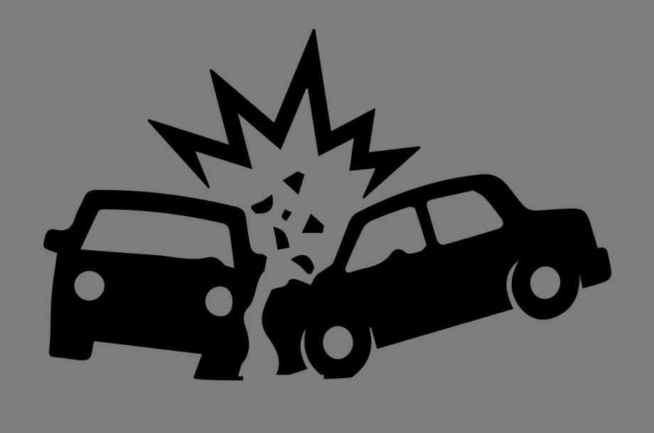
Vehicle Collisions in Canada
Alexis
Karan
Falgun
Ivy

Slide 2







Data Analysis
Conclusion
Data Sources
Introduction
Data Cleaning
Limitations

Slide 3

Motivation
Introduction
Brainstorming
Defining
Notes:
Our motivation for this project came from the Motor Vehicle Insurance cost in Canada. But as the Insurance industry is highly regulated, it is hard to find the data for the cost analysis. As Insurance cost is associated with the Accidents, we landed up deciding for this project. So we can analyse what are the reasons for the Insurance cost varies from person to person

Slide 4


National
Collision
Database
(Publisher: Transport Canada)
NCDB
Data Sources
2015
2016
2017
Selection
Source: https://open.canada.ca/data/en/dataset/1eb9eba7-71d1-4b30-9fb1-30cbdab7e63a
Notes:
National Collision Database (NCDB) – a database containing all police-reported motor vehicle collisions on public roads in Canada. Variables (data elements) relating to fatal and injury collisions for the collisions from 1999 to the most recent available data in 2017. However, we have selected only the last 3 Years of data for our analysis

Slide 5
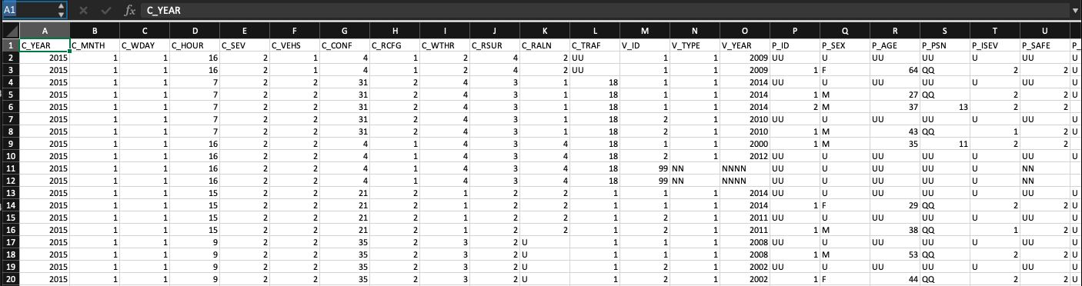
Dataset snapshot

Slide 6



Data Cleaning

Slide 7
Data available for analysis have unknown and some sensitive data due to jurisdiction requirements. Hence the need for clean up of datasets
Age related datapoints were analyzed for Age Analysis. According to Insurance Bureau of Canada, age factor is involved in Risk analysis for accidents
Assumptions
As per the dataset, data columns have values of 'UU' or 'U' for Unknown & 'XX' or 'X' for Jurisdiction, which is undisclosed data points
Also, collision data for o to 16 years old drivers were were clubbed together to avoid confusion

Slide 8
Data Cleaning:
df_without_uu = df_ncdb[df_ncdb['C_MNTH']!='UU' & (df_ncdb['C_WTHR']!='XX')]
Data Slicing:
# Change P_AGE integer data type
df_driver_age['P_AGE'] = df_driver_age['P_AGE'].astype(str).astype(int)
# Create bins for age
age_bins = [0,16,26,36,46,56,76,99]
age_names = ["<16","16-26","26-36","36-46","46-56","56-76",">76"]
df_driver_age['P_AGE_bins'] = pd.cut(df_driver_age['P_AGE'],age_bins,labels=age_names)
Example

Slide 9
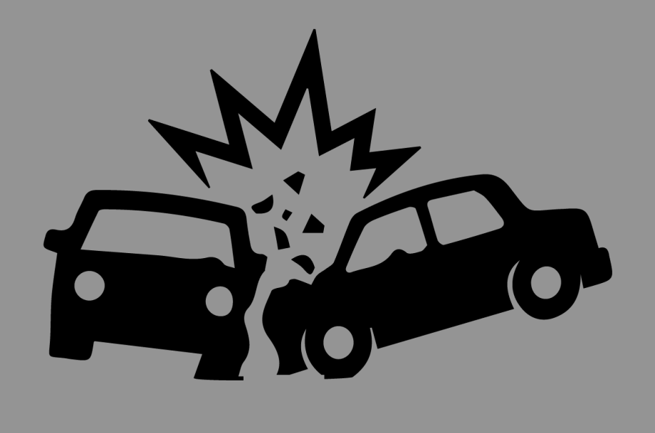

Collisions Vs Year
Collisions Vs Year & Month
Data Analysis
Collisions Vs Hour of the day
Collisions Vs Weather Condition
Collisions Vs Road Surface
Collisions Vs Vehicle Type
Collisions Vs Gender
Collisions Vs Age Group
Collisions Vs Gender & Age Group

Slide 10
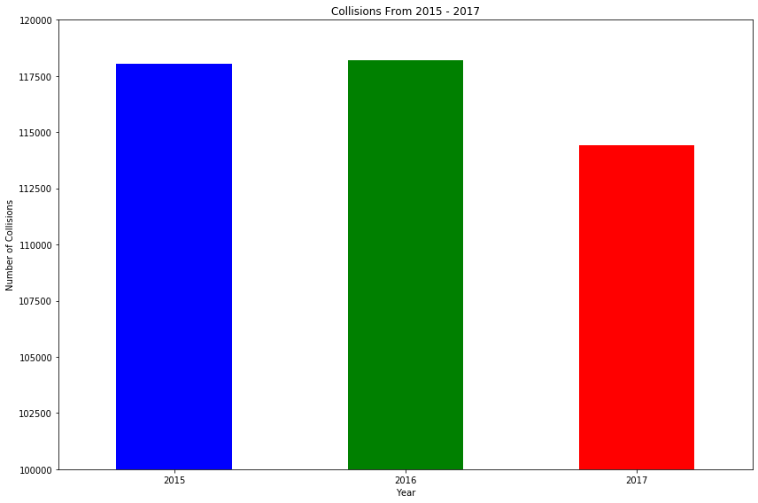
Driver vigilance increasing from 2017?

Slide 11
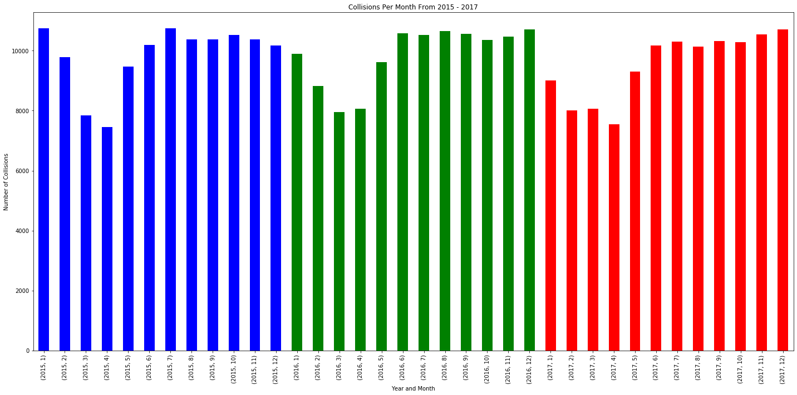
Safer in Spring, Don’t be fooled by the Sun

Slide 12
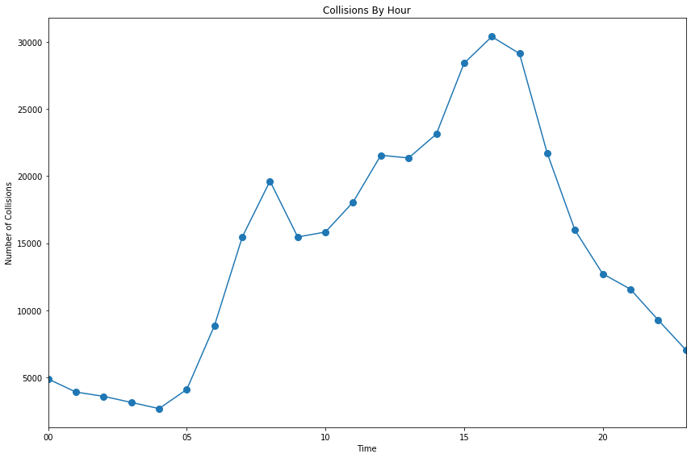
Rush Window 3 to 6pm...leave work later!

Slide 13
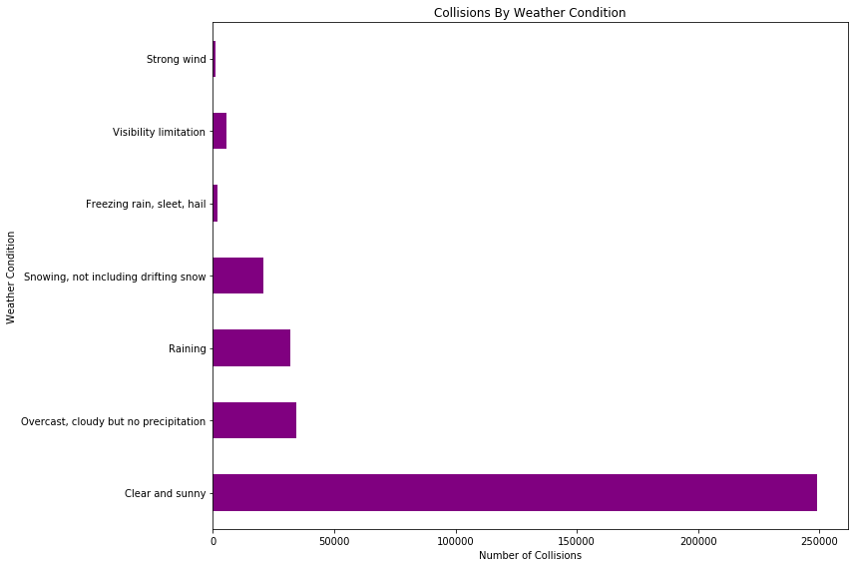
Clear days show increased risk

Slide 14
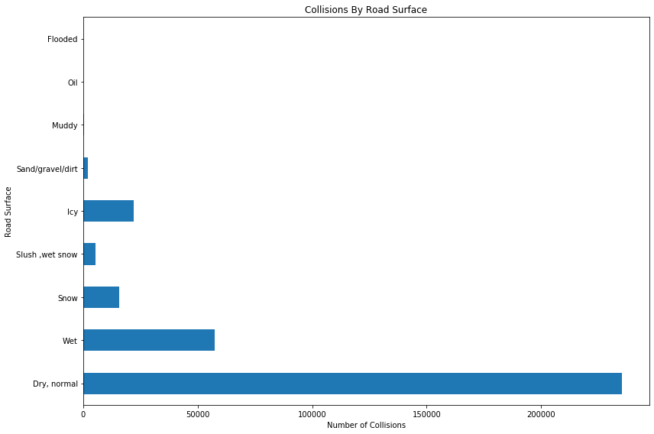
Why drive rash in normal weather ?!

Slide 15
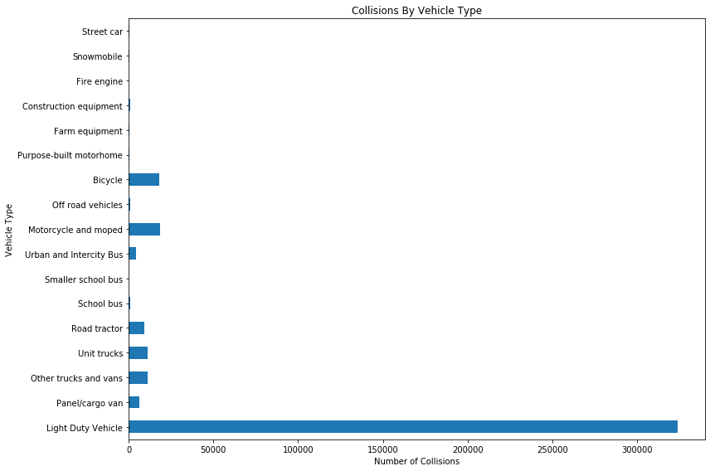
Beware car drivers!
Notes:
Can make this scatter plot. Would be more effective visualization!

Slide 16
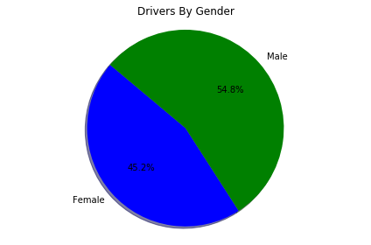
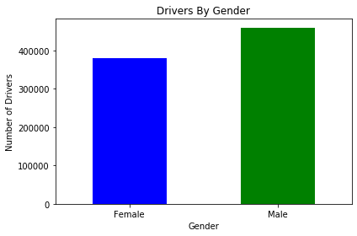
Are male drivers more careless?
Notes:
Collisions by Gender:
More number of male drivers involved in collisions than female ones
Out of more than +900k data points, almost 55% drivers were male
Male are slightly more careless drivers than female?

Slide 17
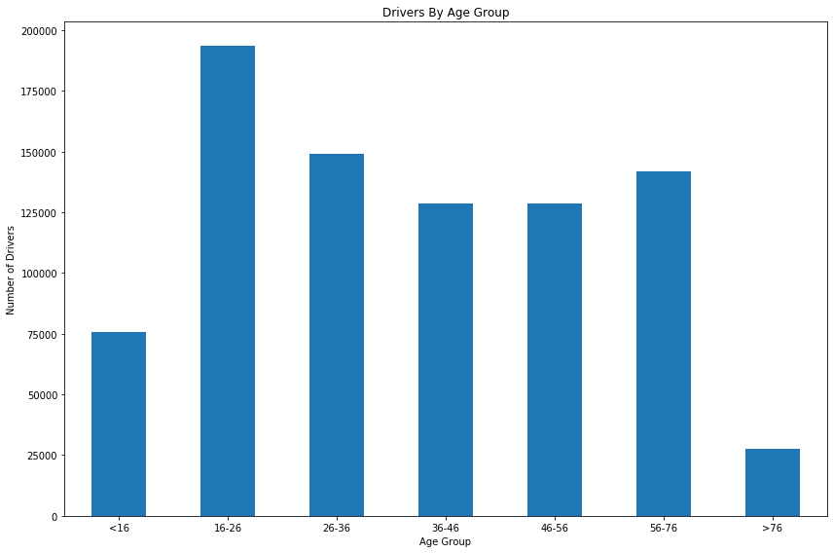
New drivers experience increased risk
Notes:
Collisions by age group:
Data shows that drivers ranging from age 16 to 26 were involved more collisions than other age groups
This could be the reason why car insurance cost are higher for people younger than 25 years
Also, there is a sharp decline in collisions for people older than 76, due to the fact that there aren’t many older people driving vehicles
Fun part: trend suggests that as you grow old, you have less collision chance but i guess once you hit 50, you become cranky and start driving rash

Slide 18
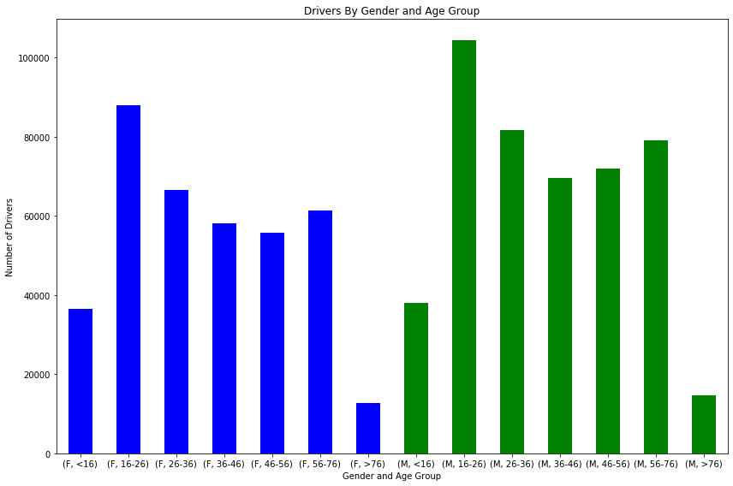
Similar trends in age are seen across genders

Slide 19

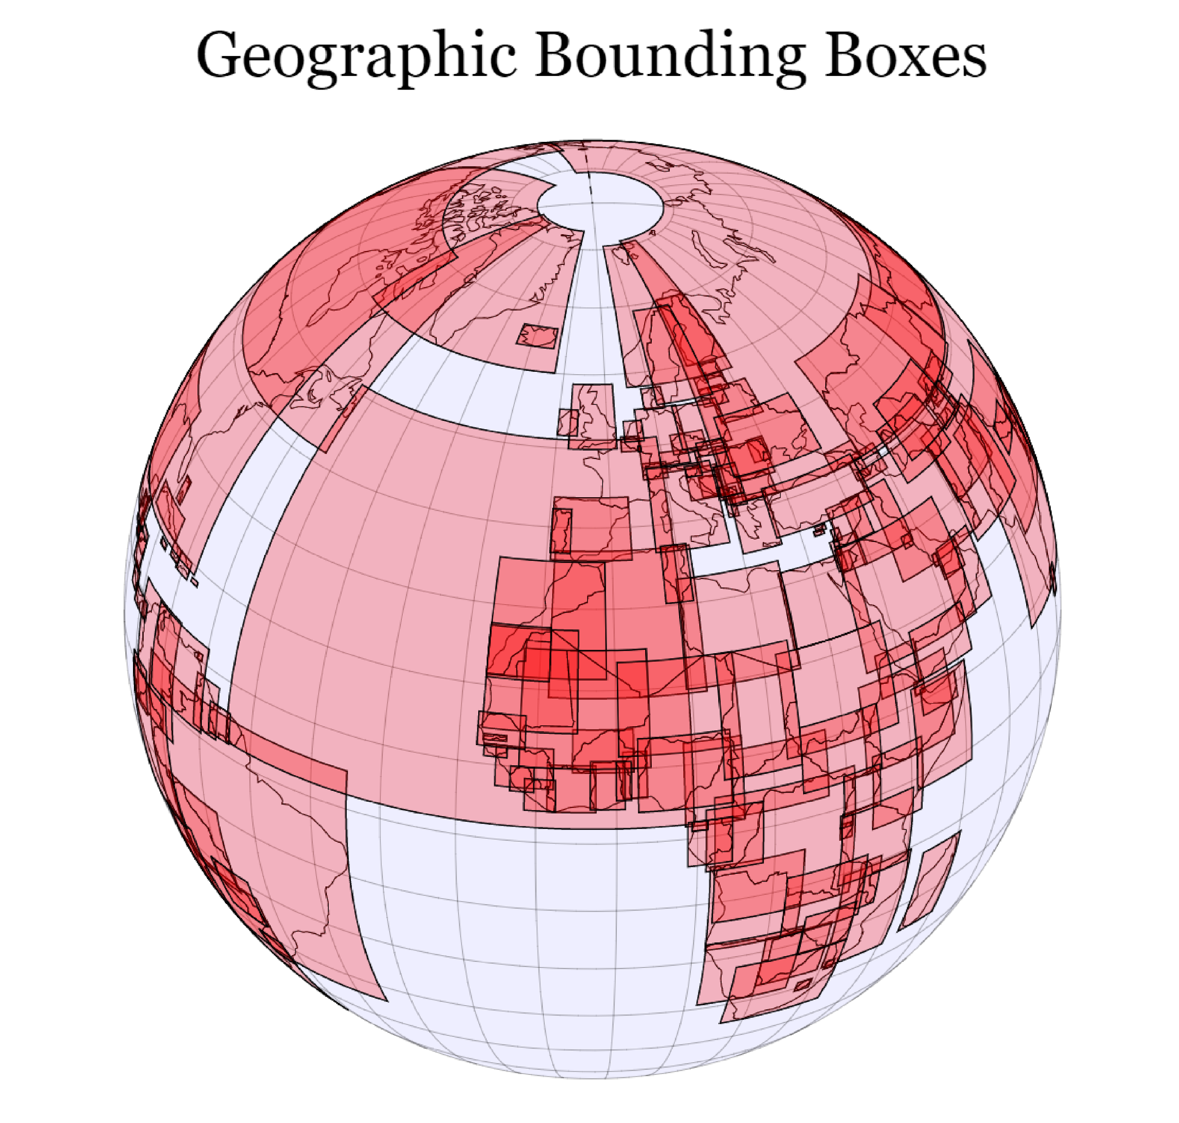
Out of ~1,000,0000 observations, ~200,000 (~20%) were not usable due to incomplete data collection (e.g. unknown, not applicable, missing case number)
Limitations
Using better plotting programs (e.g. D3) would have allowed us to create graphs that are more visually appealing

Slide 20

For new drivers, it is safest to learn to drive, practice, and gain confidence in the spring. Least motor vehicle accidents during this season
Conclusion
Clear days and normal road surfaces in the summer and winter may deceive drivers and invite overconfidence. Most accidents in these conditions. Since individuals may be eager to go out on clear days, it is important to remain vigilant when driving on these days.
Although we were not able to study Motor Vehicle Insurance cost directly, our findings on vehicle collisions in Canada may help explain why insurance cost varies from individual to individual.

Slide 21
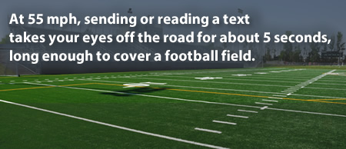
Thank You!
Source: CDC.gov

